Slide 1
Data Science Bootcamp
Introduction | the big picture | data science workflow | python programming
Anurag srivastava

Slide 2
Know your trainer
10+ years of work experience in Analytics, Machine Learning (ML) and Artificial Intelligence (AI).
Lead Instructor and Mentor for Lighthouse Labs, Oracle, Great Learning, Vodafone, Infosys, Genpact, etc.
Delivered multiple projects for multiple clients in India, Egypt, USA, Australia, Singapore and Kuwait.
Delivered multiple training sessions on Predictive & Prescriptive Analytics, ML & AI.
Successfully created M.E.L.I.S.A. for a leading healthcare company in USA.
Successfully created a NLP engine for an investment advisor company in Australia.
Successfully created automated speech engines, image recognition programs, object recognition in live video feeds and chatbots.

Slide 3
Introductions
Name (pronounciation)
Field of work (Student / IT / Construction etc.)
Pet Peeve (for Data Science)
Why are you interested in Data Science?

Slide 4
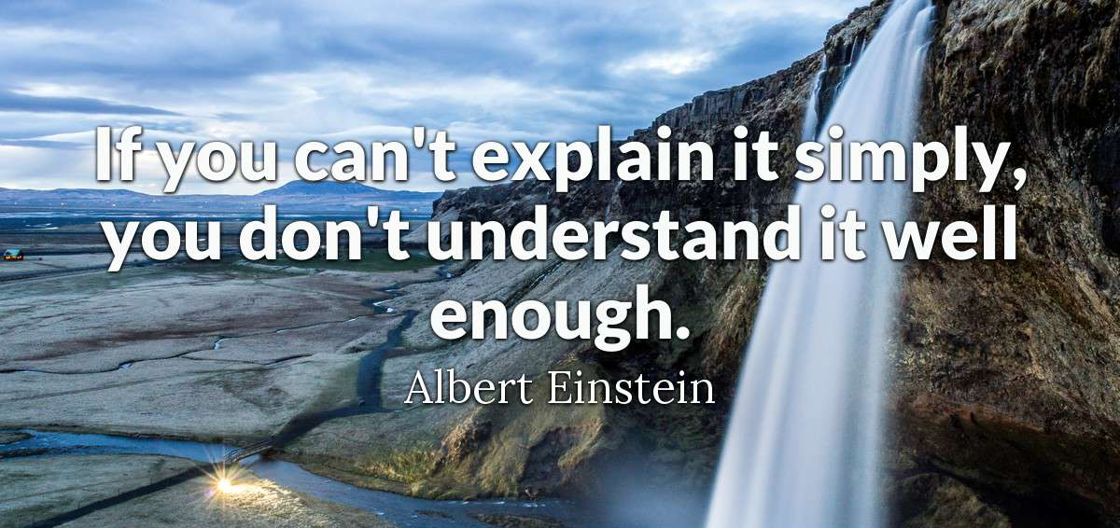
We will keep it simple …

Slide 5
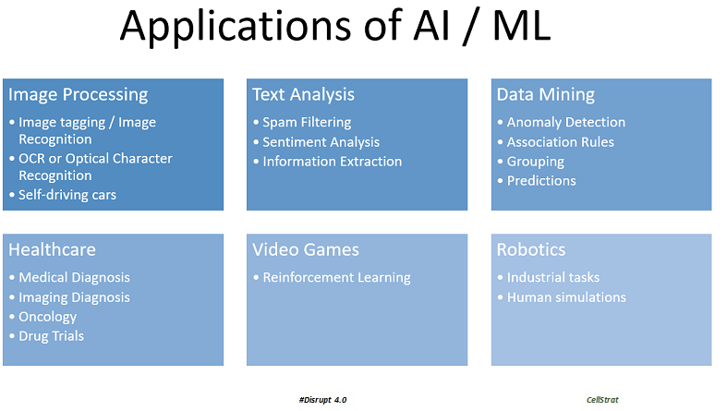
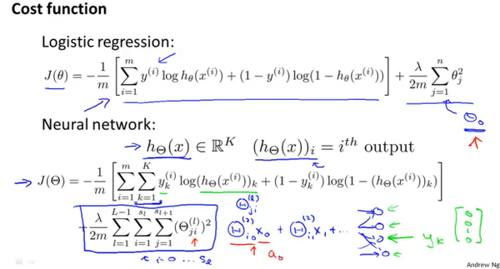
The approach to learning
✓
✗

Slide 6
The Diamond Model of learning
Converge
Converge
Diverge
Diverge

Slide 7
Did you know?
Casinos are 5 degrees cooler than other air conditioned public places such as hotels and malls? Because people are less likely to make difficult gambles in warmer temperatures.
SGI Altix supercomputer called Nautilus, to a certain degree, can predict the future. For example, it was able to predict where Osama bin Laden was hiding within 125 miles, and was also able to predict the Arab Spring that started in December of 2010.
Poker AI Libratus defeated each of its 4 human opponents just by studying their behavior in real time! For 20 consecutive days!
Google’s Artificial Intelligence Bot says the purpose of living is ‘to live forever’.
Artificial Intelligence has crushed all human records in the puzzle game “2048,” achieving a high score of 839,732 and beating the game in only 973 moves without using any undos.
Artificial intelligence systems known as ‘robo farmers’ could soon grow crops and tend livestock around Britain while their human controllers need never set foot in a field again.

Slide 8


The importance of Big Picture
So many jargons!

Slide 9

What to do?
We will talk Common Sense
No technical discussion, promise.

Slide 10
The Progression
MIS
Predictive Analytics
Prescriptive Analytics
Data Mining
Data Analytics
Machine Learning
Data Science
BI
Artificial Intelligence

Slide 11
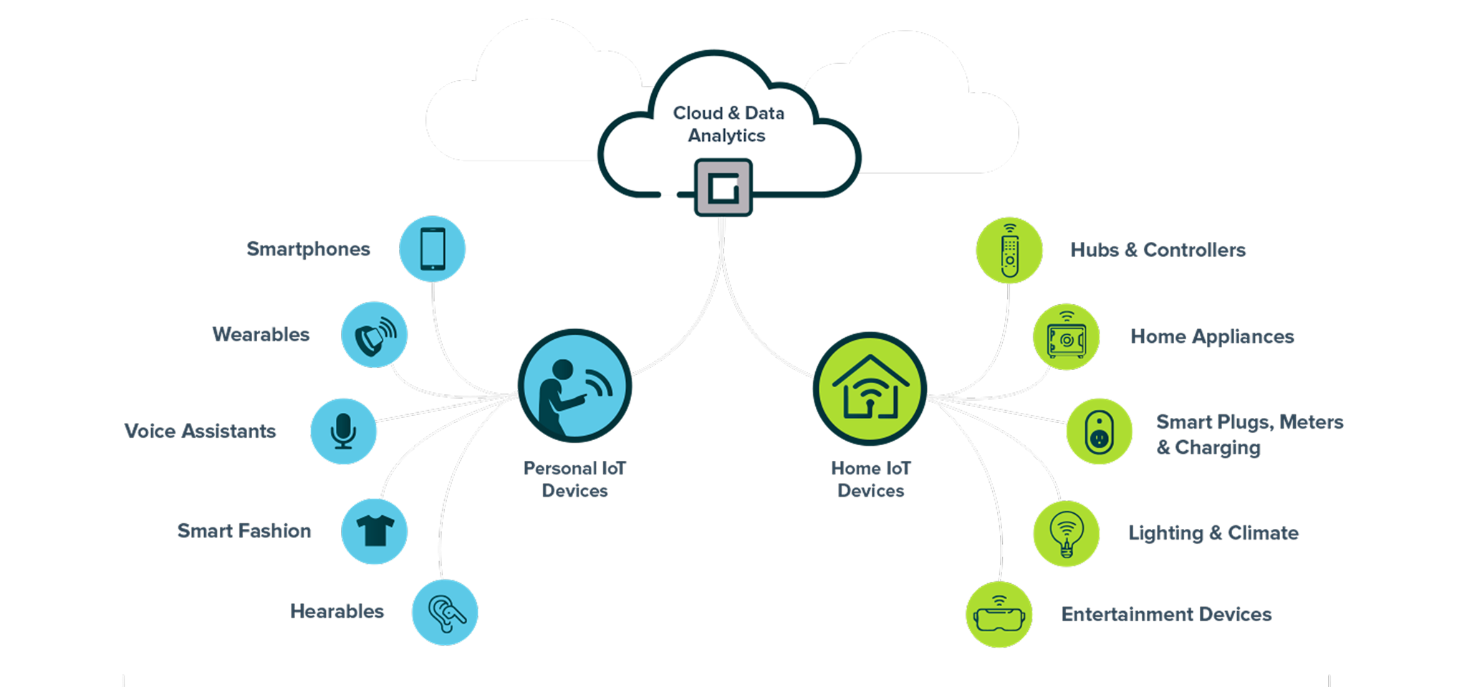
The New Buzz

Slide 12
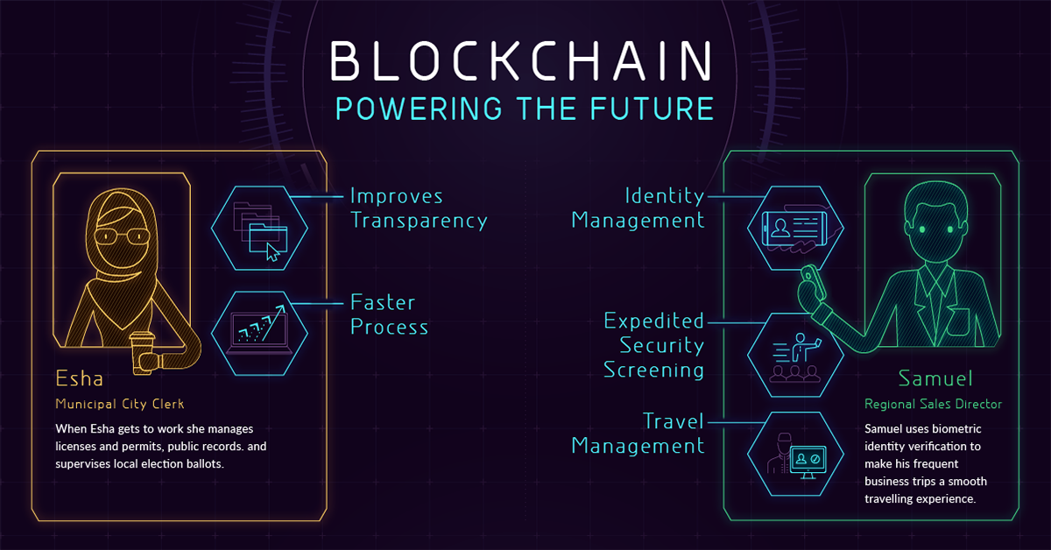
The New Buzz

Slide 13

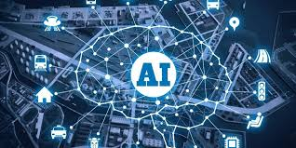
The Core of Everything!

Slide 14

Why AI? Let us Intuit.
Would you cross this bridge?

Slide 15


Why AI? Let us Intuit.
Name the fruit.
Name the fruit.

Slide 16






Why AI? Let us Intuit.
Read this.

Slide 17


Why do we need ML / AI?
The world works on hard codes.
Tons of rules are already there.
RegEx can help.
We can define everything.
Why not make it easy?
Example:
How do you make a program that can identify between –
How many codes will you write?
How many possibilities can you think of?
What happens if we want to identify a banana now?

Slide 18

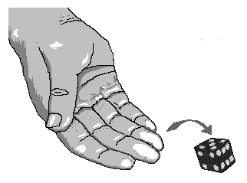
Why do we need ML / AI?
Let’s make a guess!
How many possible outcomes?

Slide 19
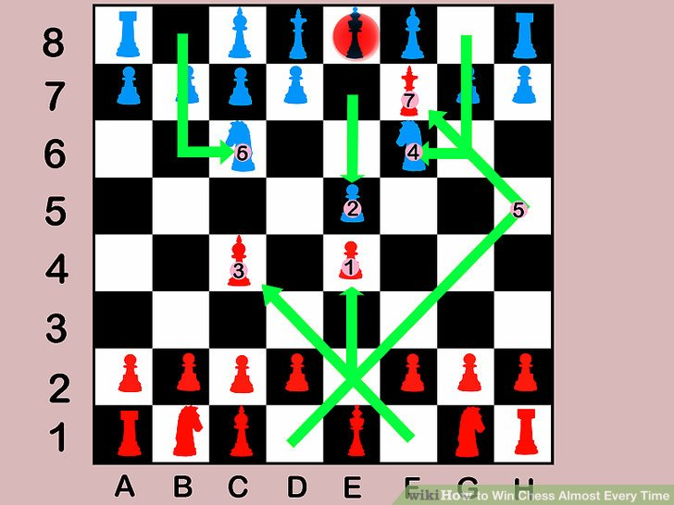
Why do we need ML / AI?
How about now?
There are 400 positions after 1 move.
There are 72,084 positions after 2 moves.
There are 9+ million positions after 3 moves!

Slide 20
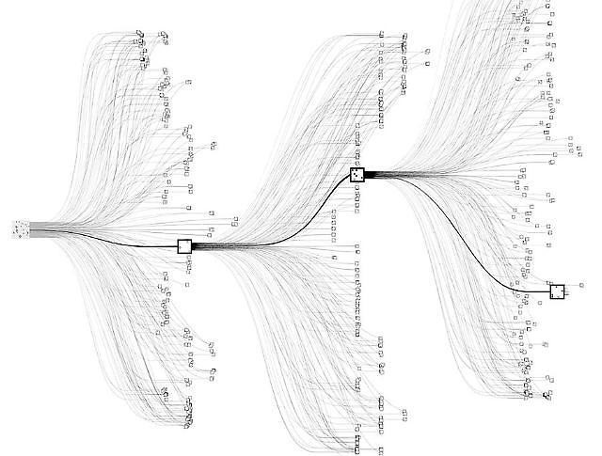
Why do we need ML / AI?
Go – an ancient Chinese board game –
the Trinity of strategic thoughtfulness.
There are more possible moves in Go,
than there are atoms in the universe.

Slide 21
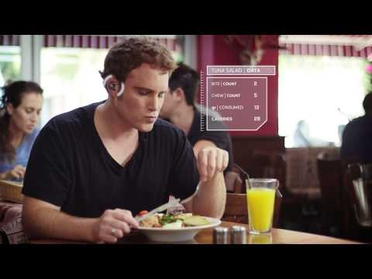
Examples of AI Systems - BitBite
https://www.youtube.com/watch?v=qU2w_qiP4Ck

Slide 22
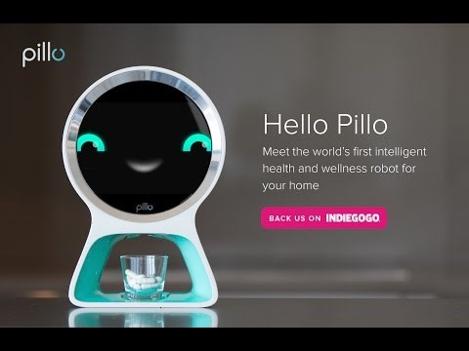
Examples of AI Systems - Pillo
https://www.youtube.com/watch?v=miEmP5l5fdY

Slide 23
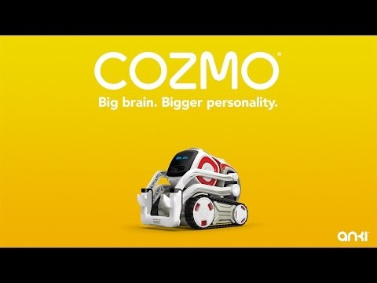
Examples of AI Systems - Cozmo
https://www.youtube.com/watch?v=cjFA531qJNE

Slide 24
So how does a computer learn?
Very similar to a child’s learning process
Example – how does a child learns to speak?
Step 1 : Listens to a plethora of words (from parents) … Speech Recognition
Step 2: Associates meanings to words (trial and error) … NLP
Step 3: Associates output to a word / combination of words … Pattern Recognition (example – mum means water)
Step 4: Repeats the uttering of words to confirm output (every time mum is uttered, water is provided)
Step 5: Starts to form sentences
Step 6: Keeps learning new words
Step 7: Builds further on the gained information (example – learning physics in school)

Slide 25
Fundamental Logic behind AI
So the key is –
Learn by experimentation
Identify patterns
Remember occurrences
Transfer the learning to another process
Repeat
The ultimate aim being – get as close to perfection as possible.
In the end, any AI project is nothing but –
Multiple APIs working together, continuously. Difference – They learn.

Slide 26
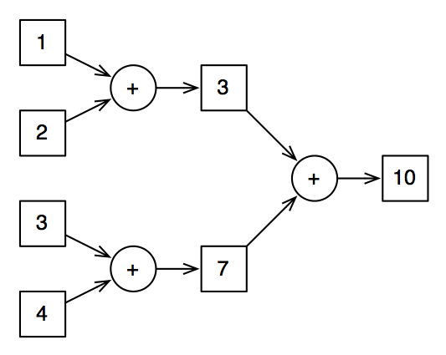
Simple Example of AI Training

Slide 27
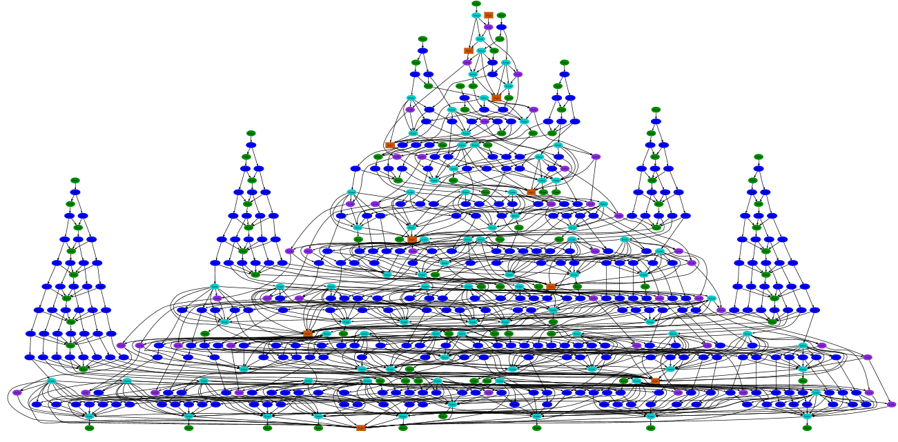
Getting inside the AI Brain

Slide 28
Key ingredients of AI
Useful Data … tons of it!
Correct Format
Correct set of instructions
Hardware capability
Data Scientists (Coaches)

Slide 29
Steps of any AI Project
Train
Test
Optimize
Deploy
Reiterate

Slide 30
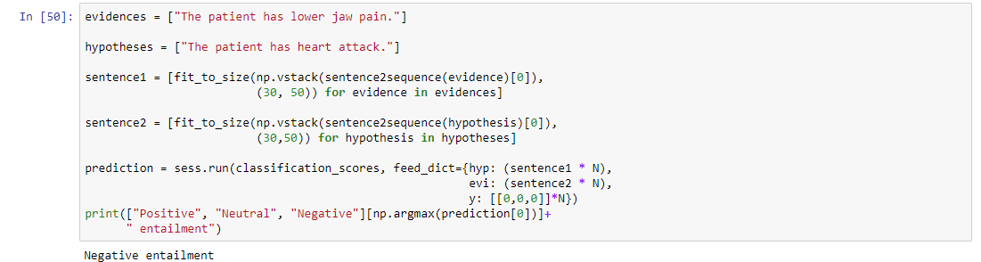
AI in Application

Slide 31
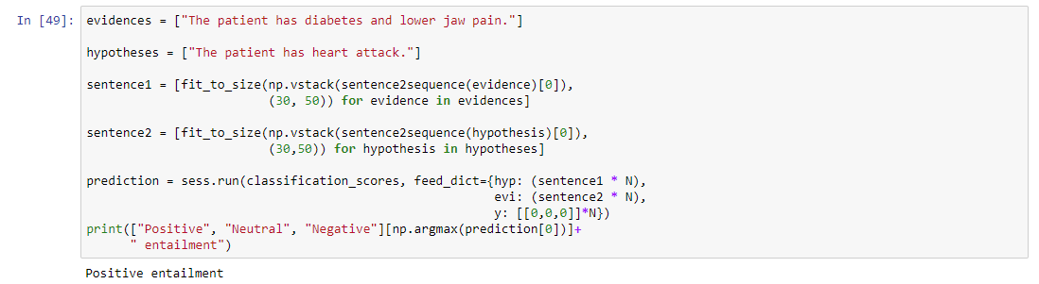
AI in Application

Slide 32
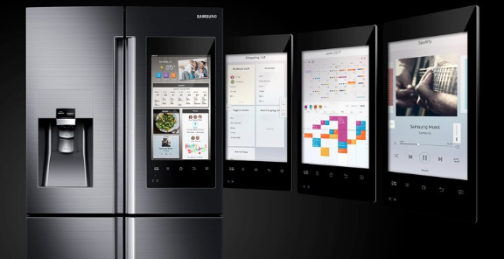
AI Use Case – e Commerce
Build website in minutes.
Online grocery app – powered by AI.

Slide 33
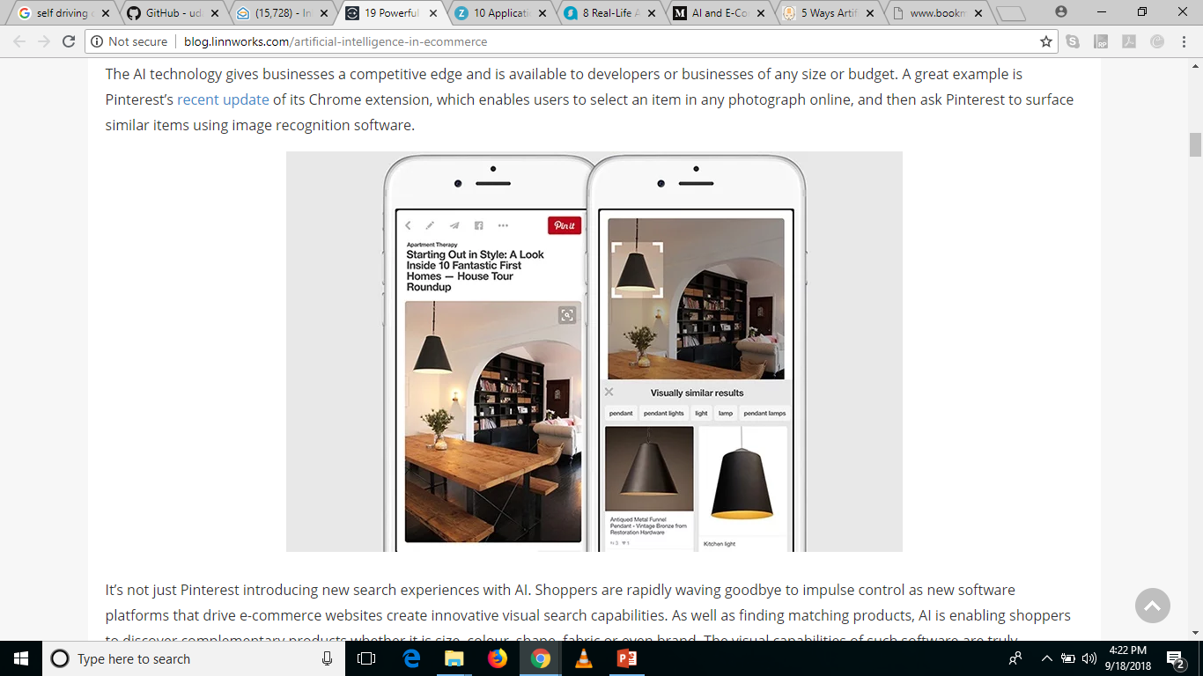

AI Use Case – e Commerce
App that suggests recipes using the inventory of your fridge – Chefling
Custom Search – Pinterest.

Slide 34
AI Use Case – e Commerce
Chatbots
Virtual Assistants
By using Alexa on Amazon’s Echo device, customers can discover local gigs for the upcoming weekend through StubHub, arrange transport to and from the event via Uber, or even order pre-event dinner from Domino’s (and track the order status in real time).
Wish
On the spot personal pricing
Tackle fake reviews
www.fakespot.com
Inventory Management & Sales Forecasting
Generating product descriptions in any writing style

Slide 35
AI Use Case – Financial Services
Driving styles and penalty points can lead to higher premiums.
Wallet – Personal Financial Management
Analyzes your entire web footprint and creates a spending graph
Accordingly suggests investments
Medically fit customers will pay lower premiums those who share their data with providers. (Fit – lower risk of future diseases)
This will change month over month
Fraud Detection, Credit Scoring and Classification of customers (defaulter vs non defaulter).
Parsing Financial Deals (J.P. Morgan Lawyers) takes few minutes today. JP Morgan has harnessed the power of this application of AI - COiN, leading to freeing 360,000 hours (yearly) from its employees’ load in only a few seconds.

Slide 36
Imagine Real Time Modules
Deception detection in speech
Image verification – KYC – document photo and selfie
Reading handwritten forms / applications (any language)
Intuitive client risk profiling (social media data + financial data)
Voice based initial screening of loan applicants - https://www.youtube.com/watch?v=oUf9_rS1fYg
Transactional bots - digital assistants helping users navigate their finance plans, savings, and spending based on web footprints.
OCR can be used to digitize hard copy documents. An NLP model with layered business logic can then interpret, record, and correct contracts at high speed.

Slide 37
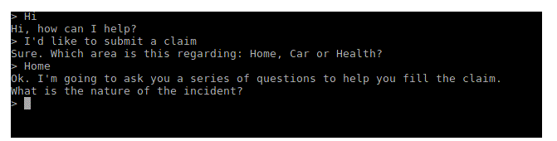
Transactional Bots
Automated Claims Processes –
Walks the customer through the process, step by step, in a conversational format.
It asks for videos or photos of the damage and uploads them to the database. It takes in all the information required for the processing of the claim. The bot can then run the application through a fraud detection method, looking for anomalies and non-compliant data.
It then moves on to the adjustment model where it provides a range of values for payout. Once all data is set, human intervention can be included for auditing purposes. The bot can at this point calculate and propose payout amounts, based on a payout predictor model it has been trained on.

Slide 38
Transactional Bots
AI assistance with claims settlement is fast and more successful.
And fast means — 3 seconds from claim submission to payment. This is the result of the independent work of Lemonade’s AI - Jim.
Lemonade is a New York based Insurance startup.
What AI can do is to assist, advise, and create a better customer experience. At the moment, AI complements human work and makes it more efficient, but it isn’t aimed to replace a human.

Slide 39
Other Applications
Limited by your imagination – think out of the box!
Whatever a human can do, AI WILL do it for you.
Make it read a book, extract summaries, make precis, identify relevant information, create videos, create models, create text to images, write a story around an image, NLP, Speech Recognition and upgrades to Jarvis (Iron Man), read your handwriting (Scribbling apps), correcting grammar in sentences, self driving car, create applications, create music, movie scripts, etc.
https://github.com/udacity/self-driving-car-sim
Suggested Movies for AI ideas and applications –
The Imitation Game
Eagle Eye

Slide 40
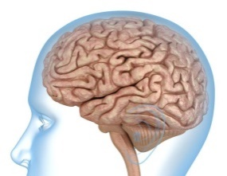

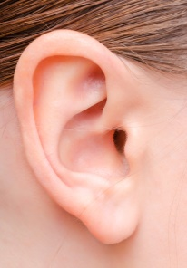

To conclude, What is AI?
Machine Learning
(Pattern Recognition)
Image Recognition /
Computer Vision
AI
Speech Recognition
Natural Language
Processing (NLP) /
Speech Engines

Slide 41
What is Data?
Data is the behavioral representation of customers, processes, machines etc.
Quantitative
Qualitative

Slide 42
Why do we need a programming language?
Computer doesn’t understand English, French, Spanish, Hindi etc.
It only understands binary (1 & 0).
But since we aren’t all mathematicians and computer engineers, we need syntaxes from programming languages.

Slide 43
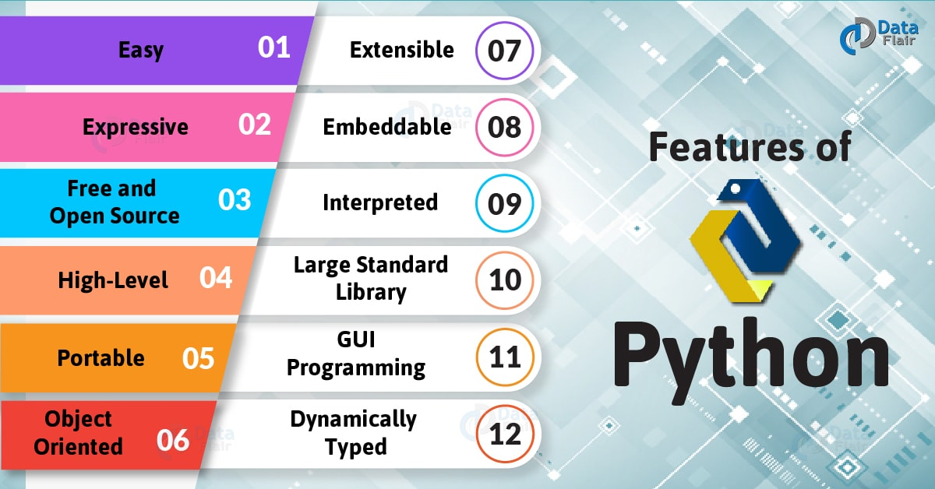
Importance of Python in Data Science

Slide 44
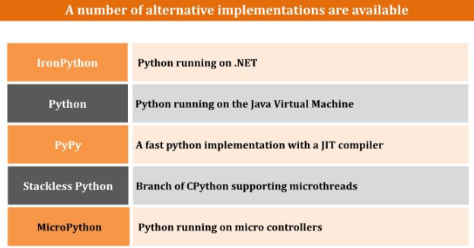
Python Implementations

Slide 45
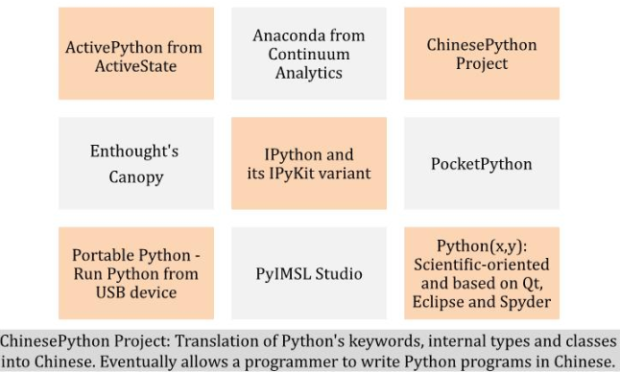
Python Distributions

Slide 46
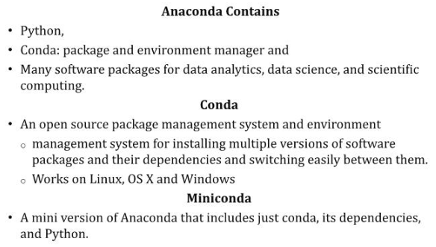
Anaconda

Slide 47
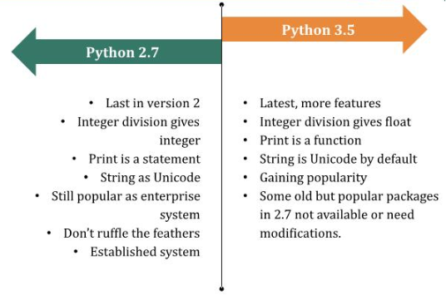
Best versions of Python

Slide 48
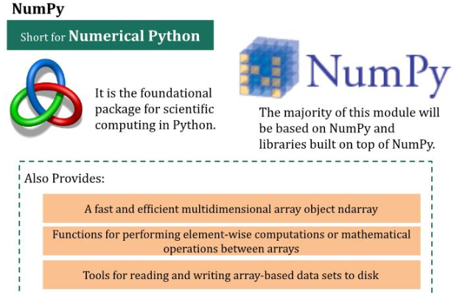
Essential Python Libraries

Slide 49
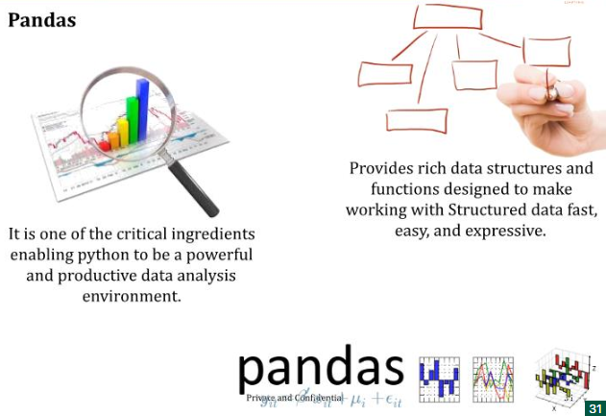
Essential Python Libraries

Slide 50
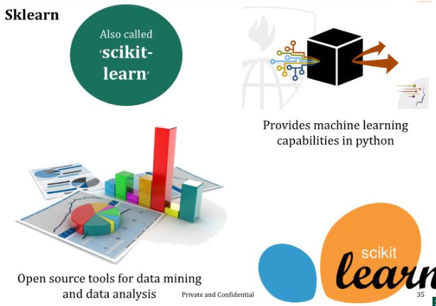
Essential Python Libraries

Slide 51
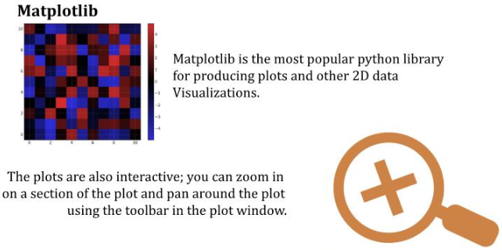
Essential Python Libraries

Slide 52
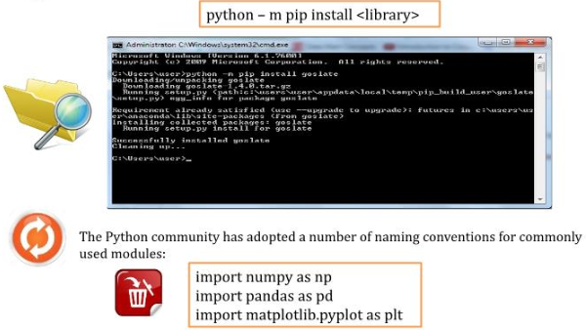
Installing Packages using Pip

Slide 53
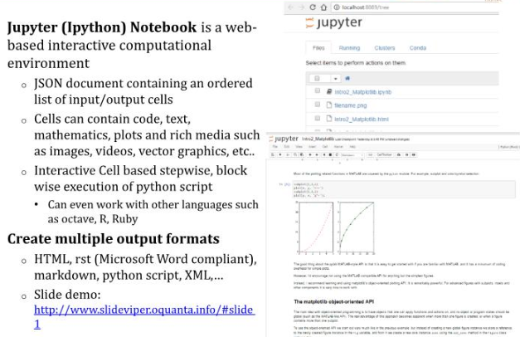
Ipython Notebook

Slide 54

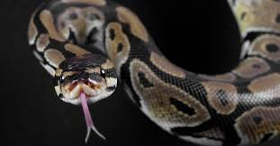


Why is it called Python?
When he began implementing Python, Guido van Rossum
was also reading the published scripts from
“Monty Python’s Flying Circus”, a BBC comedy series
from the 1970s. Van Rossum thought he needed a name
that was short, unique, and slightly mysterious,
so he decided to call the language Python.
Guido Van Rossum

Slide 55
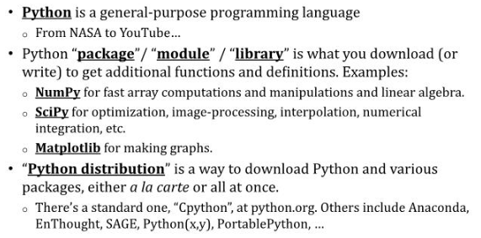
Terminologies

Slide 56
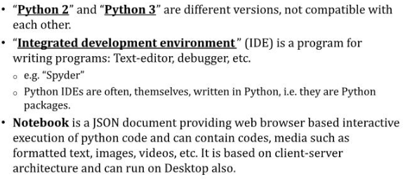
Terminologies

Slide 57
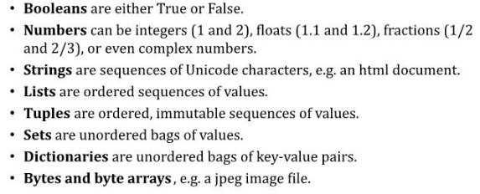
Main Native Data Types in Python

Slide 58
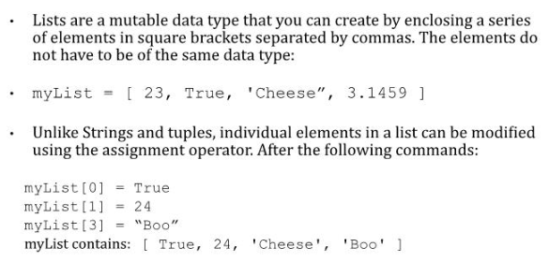
Lists – like strings & tuples but mutable

Slide 59

Different Elements, Different Type

Slide 60
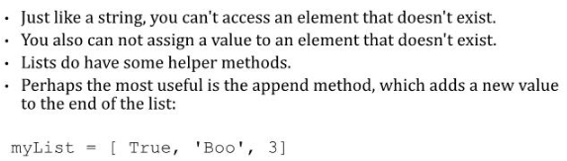
List Restrictions and Append Method

Slide 61
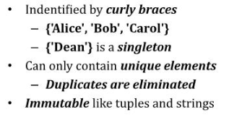
Sets

Slide 62
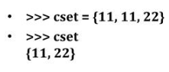
Sets do not contain duplicates

Slide 63
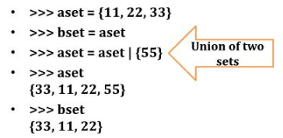
Sets are immutable

Slide 64

Sets have no order

Slide 65
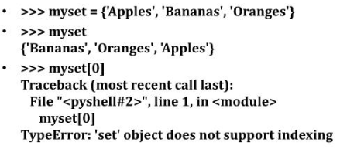
Sets do not support indexing

Slide 66

Example

Slide 67
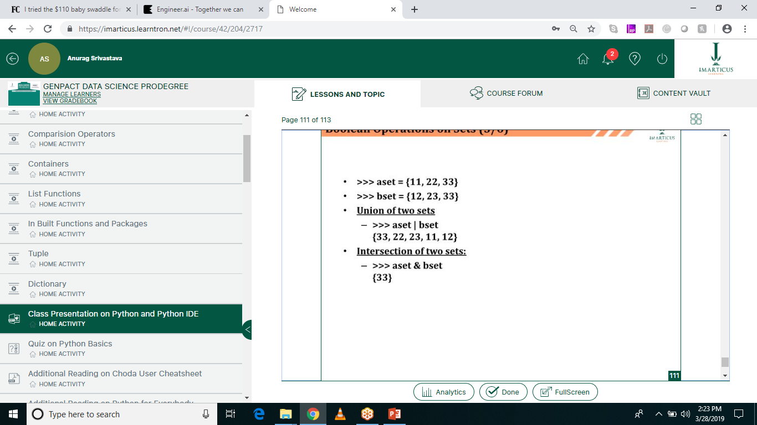
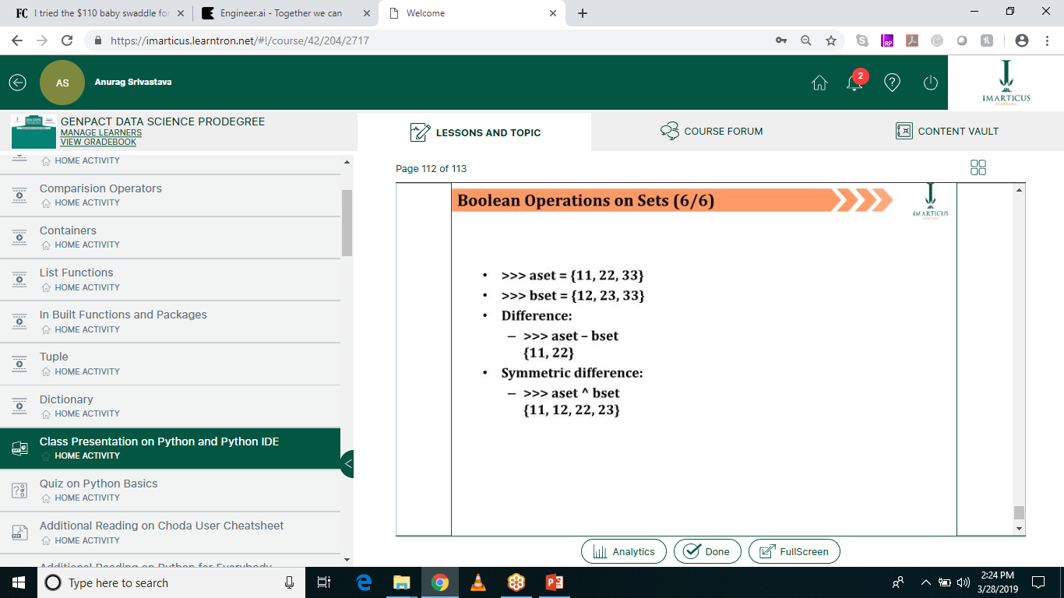
Boolean Operations on Sets

Slide 68
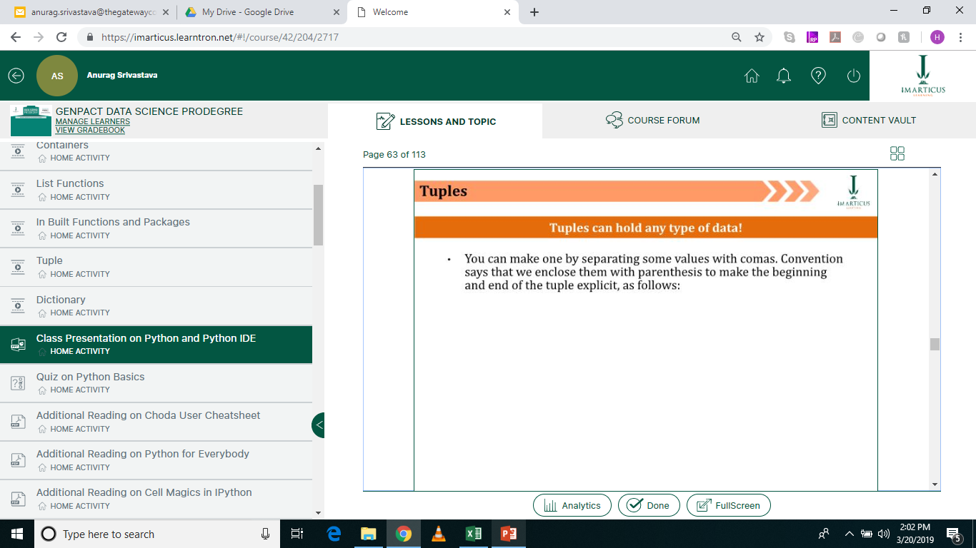
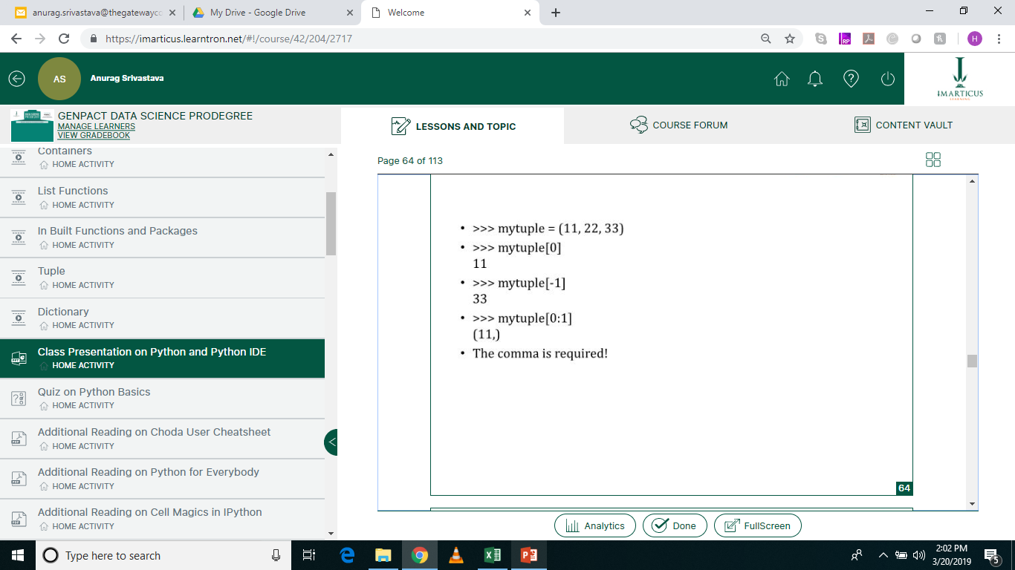
Tuples

Slide 69
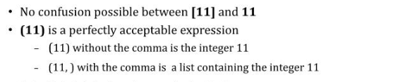
Why “comma” is important?

Slide 70
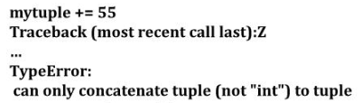
Things that don’t work with Tuples
Because tuples are immutable …

Slide 71
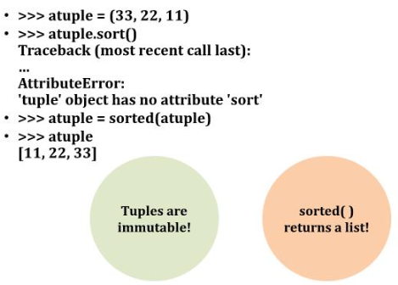
Sorting Tuples

Slide 72

What works?

Slide 73
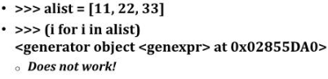
What doesn’t work?

Slide 74

Converting Sequences into Tuples

Slide 75

Using Tuples to return multiple pieces

Slide 76

Tuples are Sequences!

Slide 77

Dictionaries

Slide 78

Dictionary Example: Assessing

Slide 79

Reassigning & Creating Key/Value Associations

Slide 80

Dictionaries

Slide 81

Usage

Slide 82

Dictionaries are Mutable

Slide 83

Keys must be Unique

Slide 84

Displaying Contents

Slide 85

Updating Directories

Slide 86

Returning a Value

Slide 87

Removing a Specific Item (I)

Slide 88

Remove a Random Item

Slide 89

Strings Vs. Tuples

Slide 90

Immutable?

Slide 91
Accessing Elements - Counting
myString = “This is a test.”
len(myString)

Slide 92
Accessing Elements – Counting Backwards
myString = “This is a test.”
myString [ len(myString) – 1 ] or
myString[-1]
Similarly myString[-2] or myString[-3]

Slide 93

Index out of Range

Slide 94

Traversal – While Loop

Slide 95

Traversal – For Loop

Slide 96

Slicing

Slide 97

Cloning via Slices

Slide 98

Error and Exception Handling in Python
Error handling increases the robustness of your code, which guards against potential failures that would cause your program to exit in an uncontrolled fashion.

Slide 99
Errors and Exceptions
Errors cannot be handled, while Python exceptions can be handled at the run time.
An error can be a syntax (parsing) error, while there can be many types of exceptions that could occur during the execution and are not unconditionally inoperable.
An Error might indicate critical problems that a reasonable application should not try to catch, while an Exception might indicate conditions that an application should try to catch.
Errors are a form of an unchecked exception and are irrecoverable like an OutOfMemoryError, which a programmer should not try to handle.
Exception handling makes your code more robust and helps prevent potential failures that would cause your program to stop in an uncontrolled manner.
Imagine if you have written a code which is deployed in production and still, it terminates due to an exception, your client would not appreciate that, so it's better to handle the particular exception beforehand and avoid the chaos.

Slide 100
Types of Errors
Refer Jupyter Notebook.

Slide 101
Disadvantages of Python Exception Handling
Programs that make use try-except blocks to handle exceptions will run slightly slower, and the size of your code will increase.
You can use the timeit module of Python to check execution times.
Let’s see the example in Jupyter Notebook.

Slide 102
Shallow and Deep Copy
Shallow Copy – When two or more pointers of the same type, point to the same memory.
Deep Copy – When the contents of the memory pointed to by a pointer are copied to the memory location of another pointer.
In Simple words,
Shallow Copy – They point to same data. Deleting one deletes all pointers.
Deep Copy – Two copies of the data.
Example in Jupyter Notebook.

Slide 103
Handling Date and Time in Python
Refer Jupyter Notebook

Slide 104
Questions?
Thank you!

